Slide 1
T5.1 Prototype integration and testing platform
Review meeting – Online – July 10, 2024

Slide 2
T5.1 in brief
Task leader: WLI
Timing: M7-M36
Task | WLI | TSI | CNR | TSG | UBI | SAG | TID | EUT | TUM | IFAG | AEGIS | CAM | TOTAL
T5.1 | 12 | 3 | 8 | 2 | 10 | 6 | 2 | 7 | 2 | 4 | 2 | 3 | 61

Slide 3
T5.1 objectives
Definition of the set of common methodologies, tools and workflows for the development
Establish a code management protocol for the different modules of the platform (Pull request protocol or similar).
Manage the EDGELESS opensource repositories
Create an organization in GitHub where you can manage the life cycle of the different components developed (documentation, issue tracking).
Integrate CI/CD processes within the management of code repositories with the tools provided by GitHub (Build, Automated testing, delivery, monitoring, …).

Slide 4
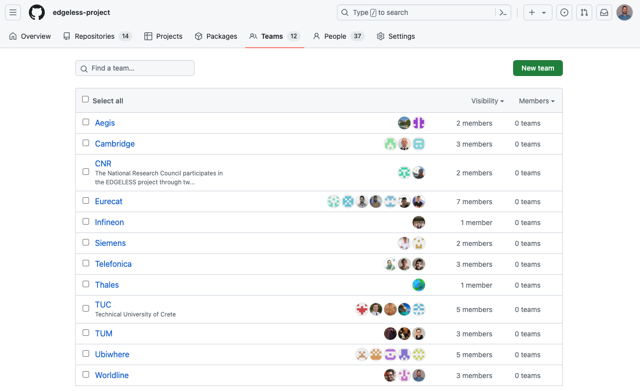
Github Organization

Slide 5
Public repositories
edgeless: Main repository, contains the reference Implementation. Several partners contributing to this repository.
ci-image: Ancillary repository, for building docker images.
prototype-legacy: Partial implementation of the EDGELESS features with state-of-the-art tools.
runtime-python: Run-time environment in Python for EDGELESS.
epd-waveshare: Forked repository.
rust-sensor-scd30: Forked repository.
code-camp-chania-2024: Repository created for the code camp challenge.

Slide 6
Private repositories
function-repository-api: Contains the Function Repository API implementation. This repository will become public in the future.
function-repository-front: Contains the Function Repository Front-end app implementation. This repository will become public in the future.
cnr-experiments: Scripts and configuration of experiments (to be) carried out by CNR within the EDGELESS projects.
github-actions-showcase: Ancillary repository for showcase and test Github Actions functionalities.
licenses: Ancillary repository for auditing OSS licenses in a codebase.

Slide 7
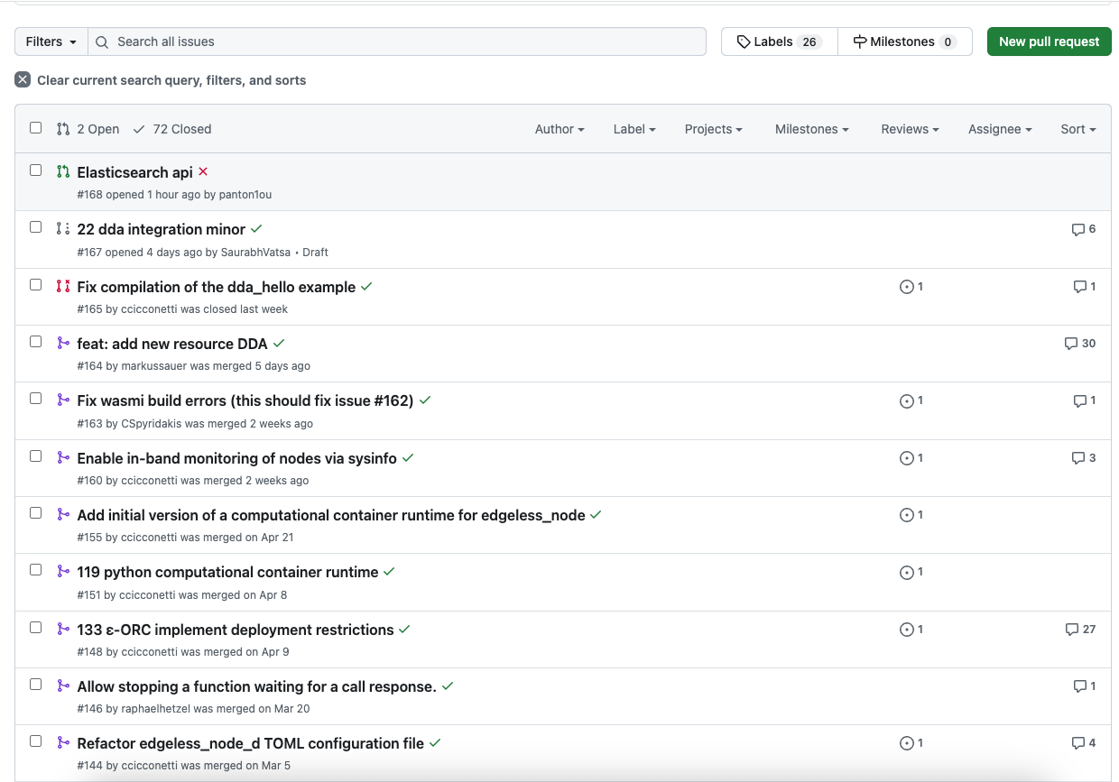
Working methodologies
Methodology for Collaborative Work, allowing multiple team developers contribute to the main repository:
Branching Strategy for New Features/Issues
Pull Request and Review Process
Maintaining a Clean Main Branch

Slide 8
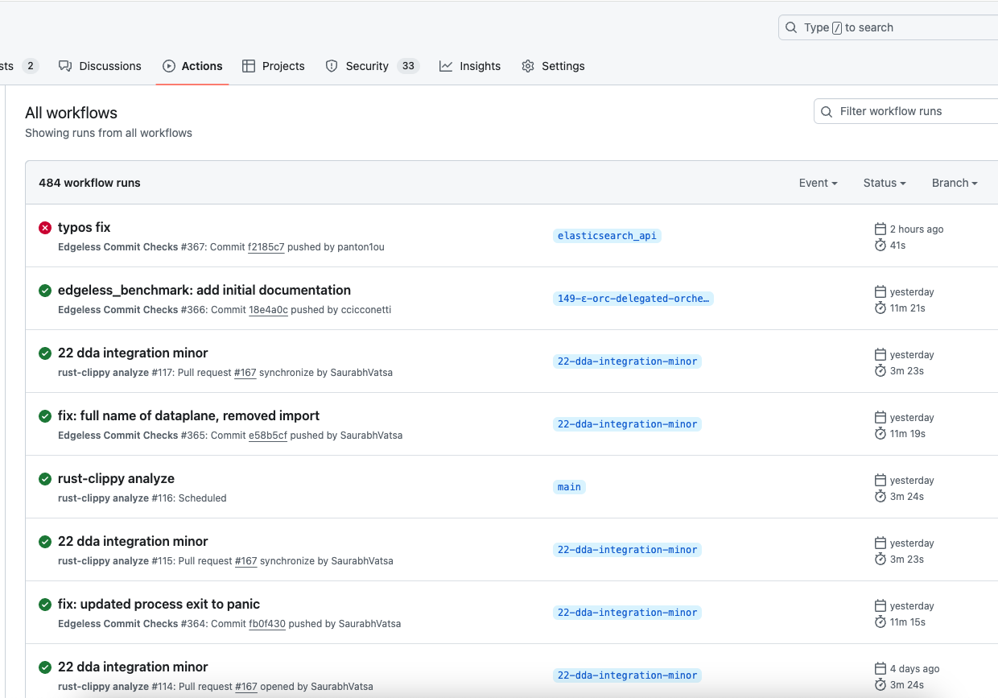
CI/CD
CI/CD: Github Actions workflows configured in some repositories:
Code validations: format checks, code linting, etc.
Build Process
Release Preparation

Slide 9
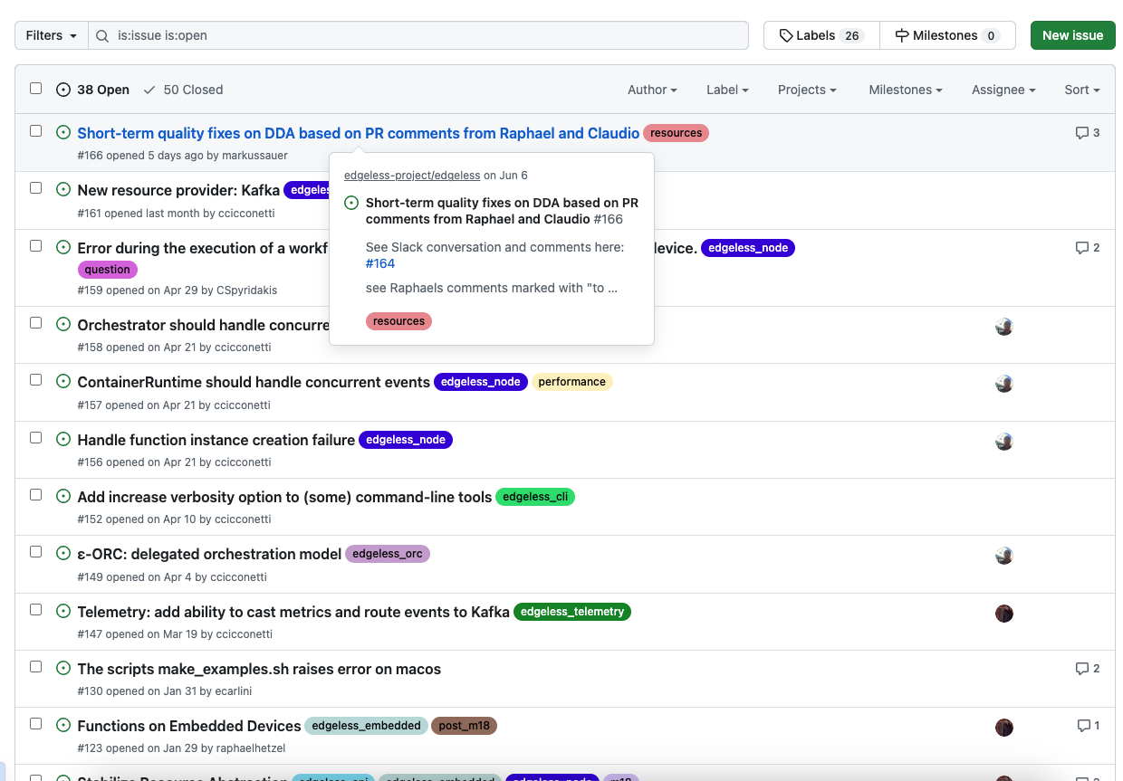
Documentation and issue tracking
Issue tracking with GitHub Issues:
New features
Enhancements
Bugs
Repositories documentation:
Well structured documentation through md files

Slide 10
Status of the integration
PDF document: integration_status_M18.pdf

Slide 11
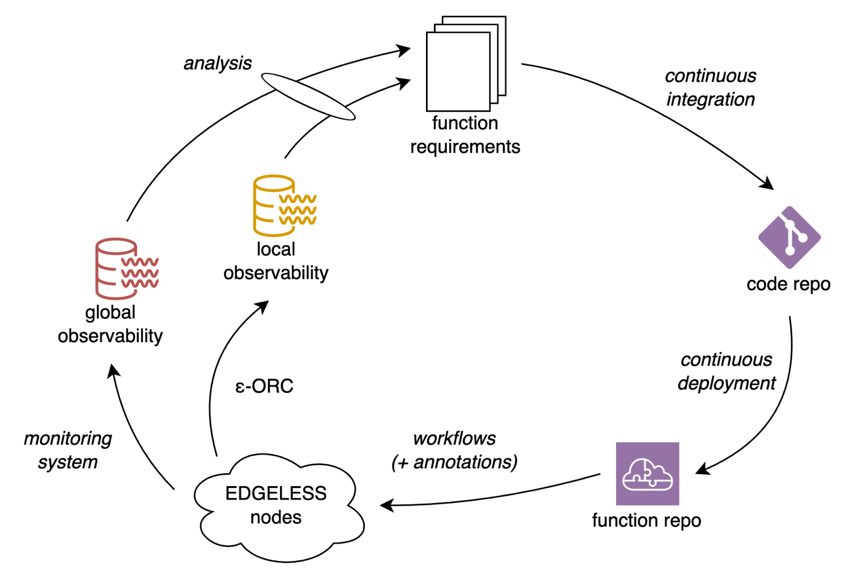
CI/CD tools for EDGELESS Functions/Workflows

Slide 12
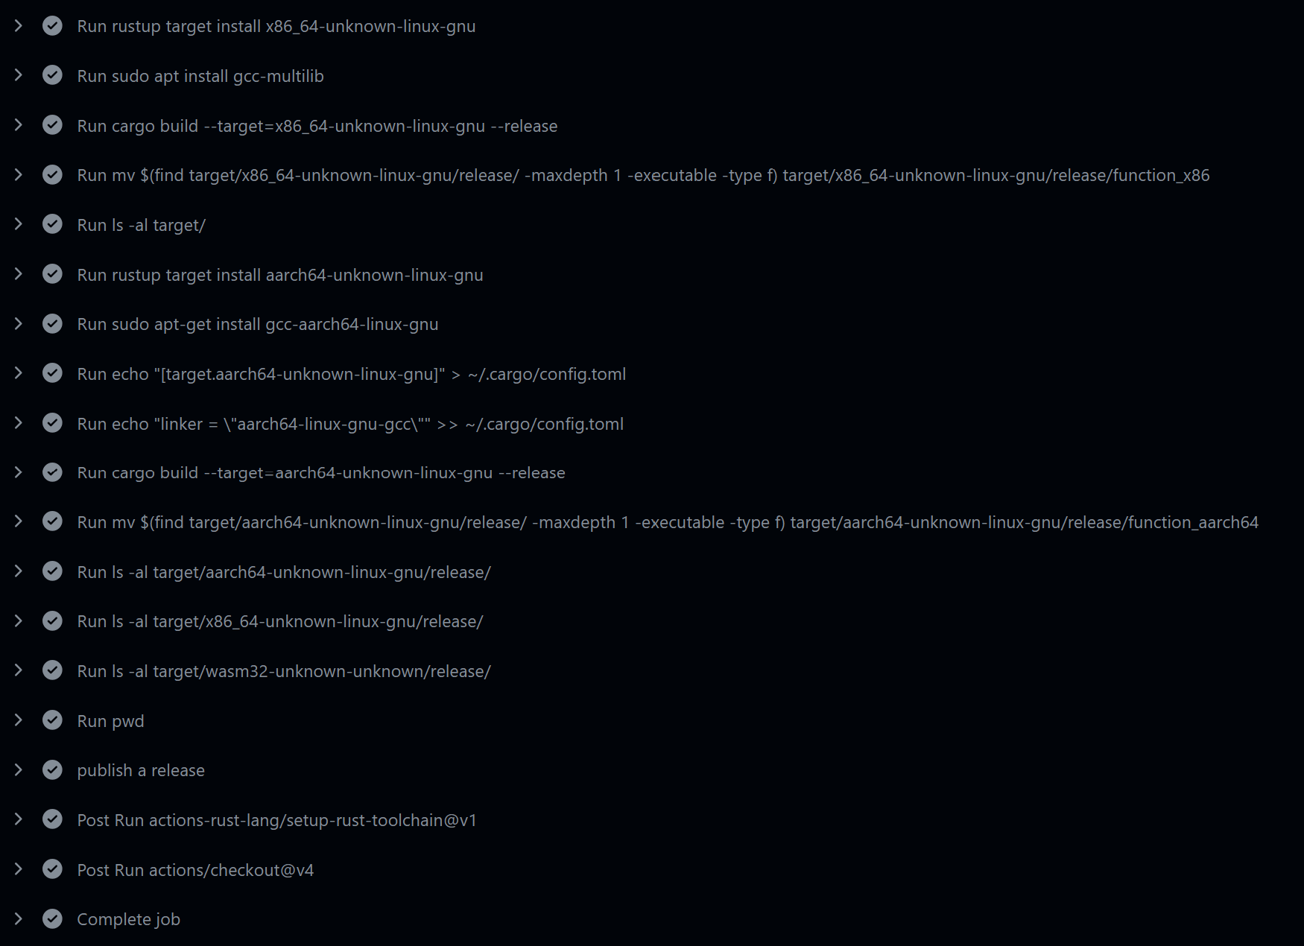
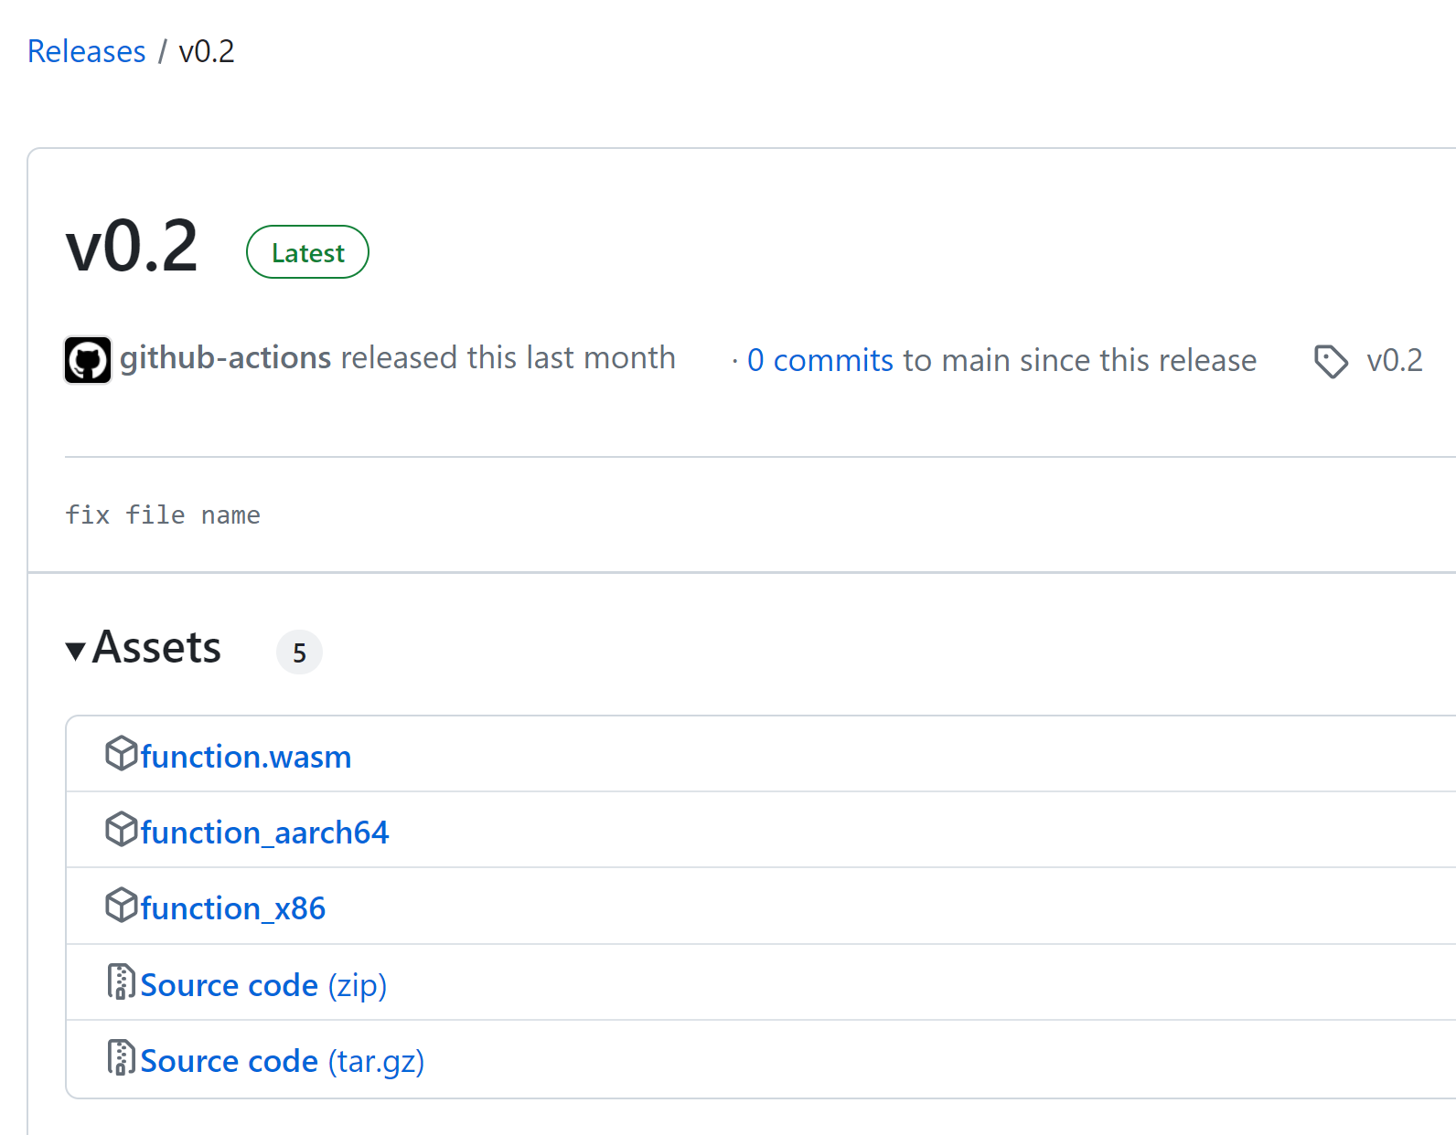


Toolchain - GitHub
Use GitHub Actions to create/publish binaries
Source code repository
Publish binaries
Github actions
Binaries for different platforms
Git push –-tags v0.2-publish

Slide 13
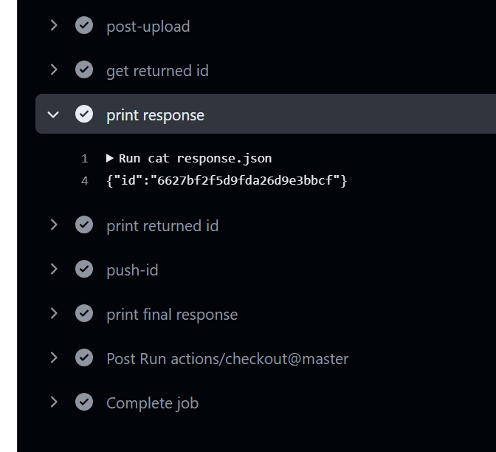
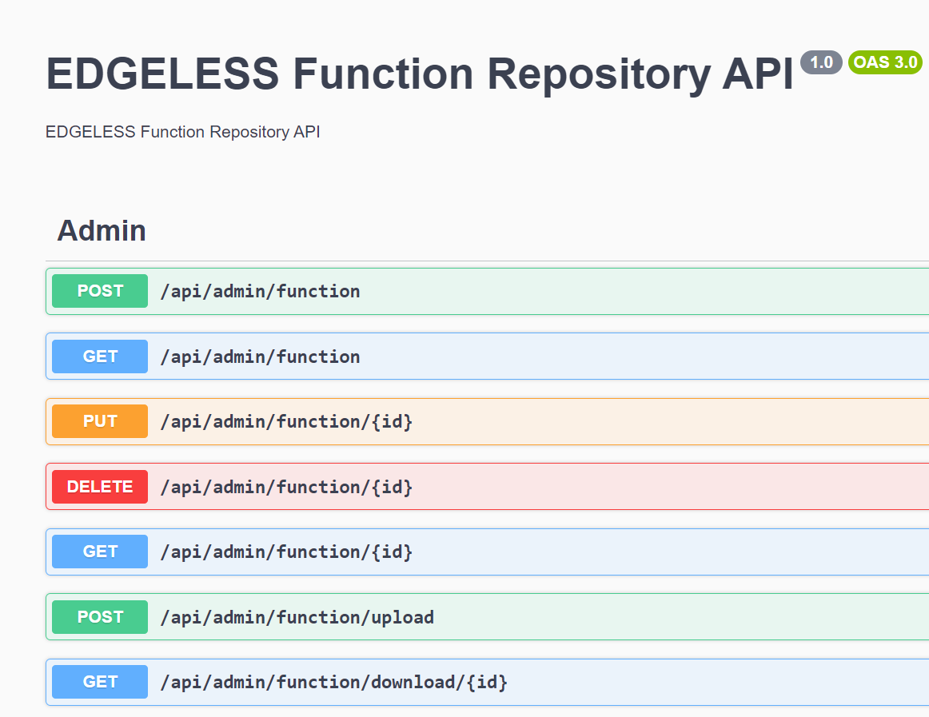
Toolchain - GitHub
Use GitHub Actions to push binaries to EDGELESS Function Repository
Source code repository
Push to EDGELESS repo
Github actions
Git push –-tags v0.2-push

Slide 14
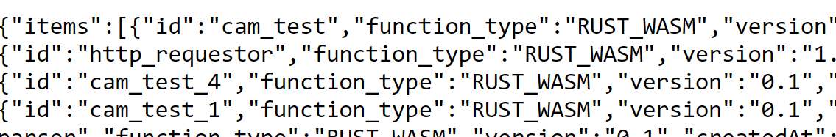

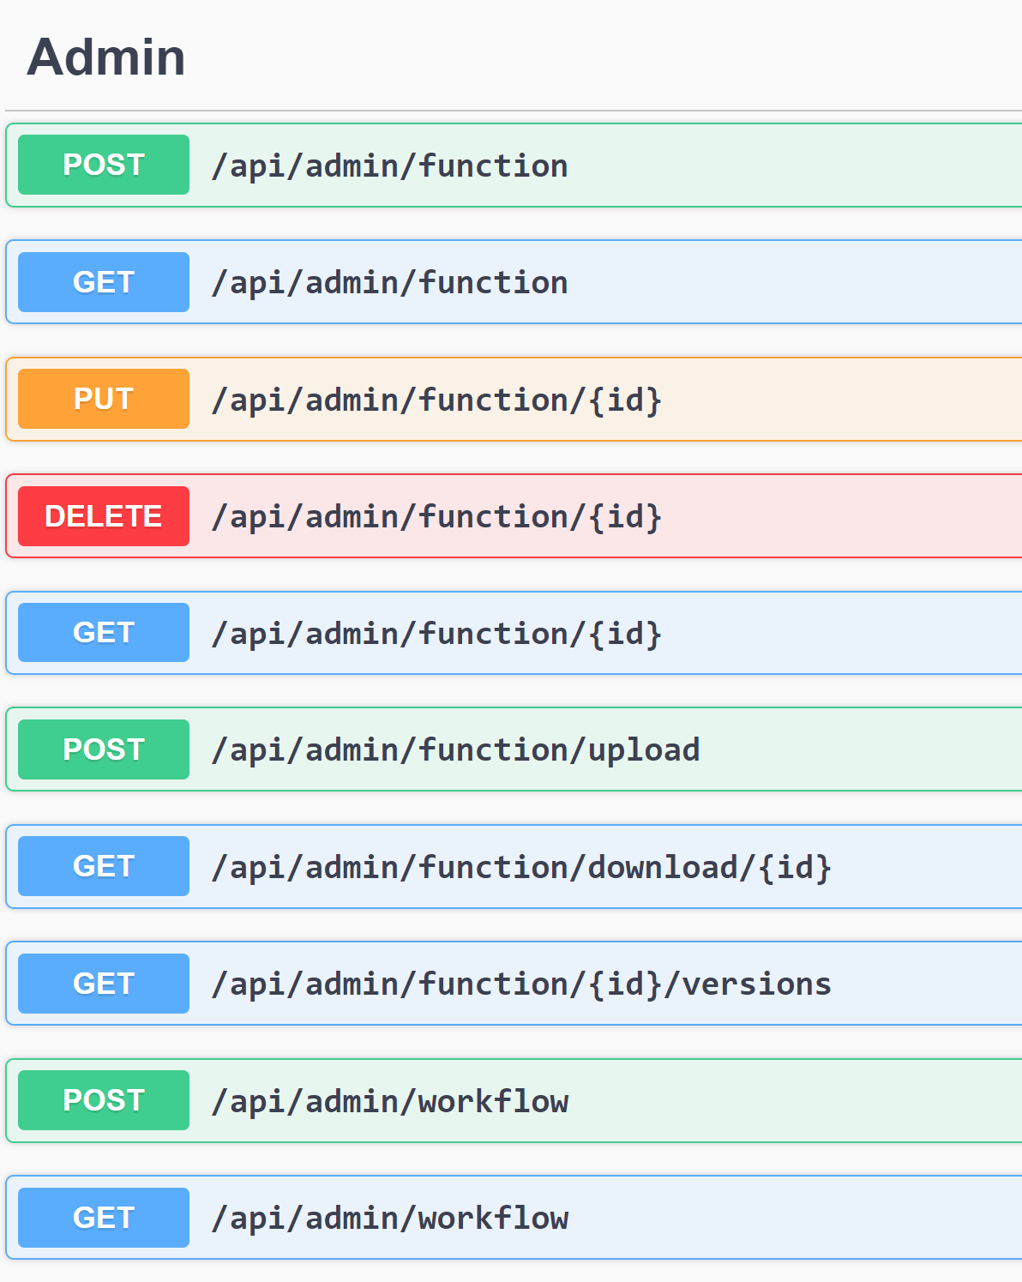

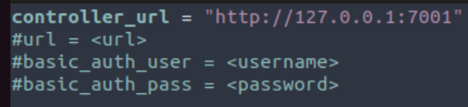
Toolchain - cli (1/3)
edgeless_cli function push function_name function_type
Edgeless Function Repository
Binaries
edgeless_cli function push
Load config

Slide 15
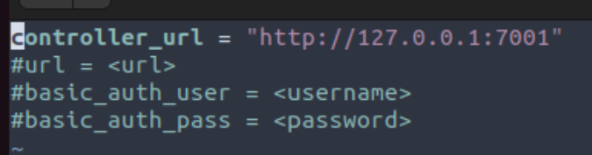
Toolchain - cli (2/3)
Generate the config file
edgeless_cli -t cli.toml
edgeless_cli function push function_name function_type

Slide 16
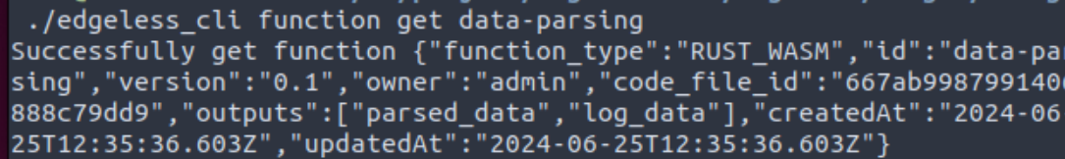
Toolchain - cli (3/3)
edgeless_cli function get function_name
edgeless_cli function download code_file_id

Slide 17
T5.1 next steps
GitHub management activities
Improve CI/CD workflows (All partners):
Automatic tests
Releases
Add GitHub Actions workflows in other repositories
Integration activities (All partners):
Refine plans and objectives for the integration M36. To be included in D5.2
Work in the integration activities
Validations (Use case providers):
Define a plan for the UC tests and validations. To be included in D5.2
Work on the tests and validations

